Slide 1
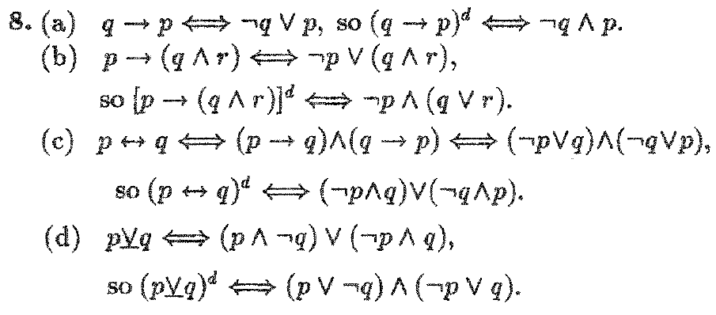
Mathematical Logic

Slide 2
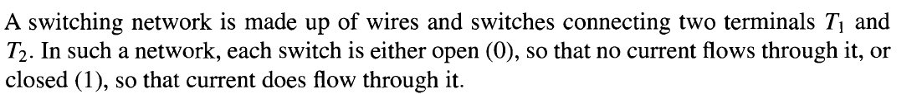
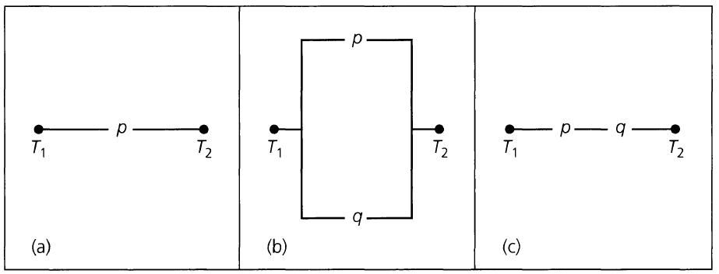
Mathematical Logic

Slide 3
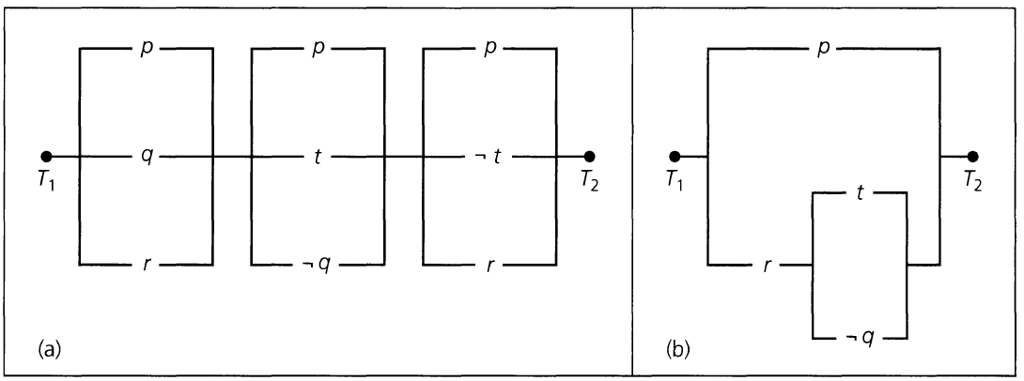
Mathematical Logic

Slide 4

Mathematical Logic

Slide 5
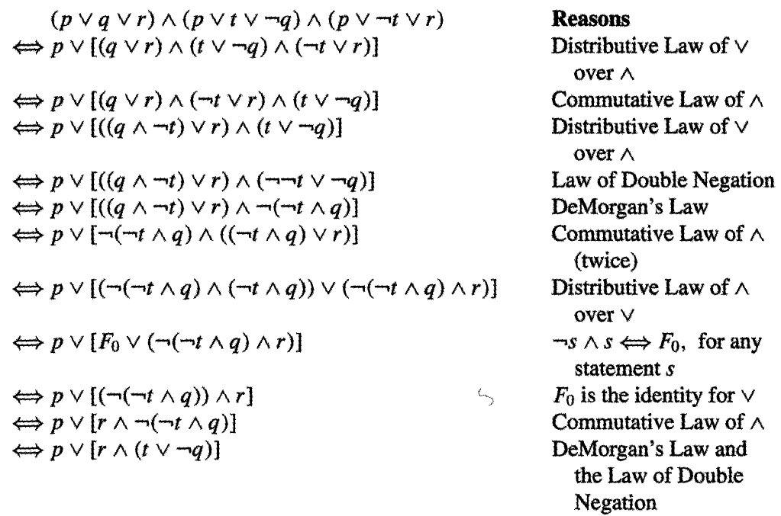
Mathematical Logic

Slide 6
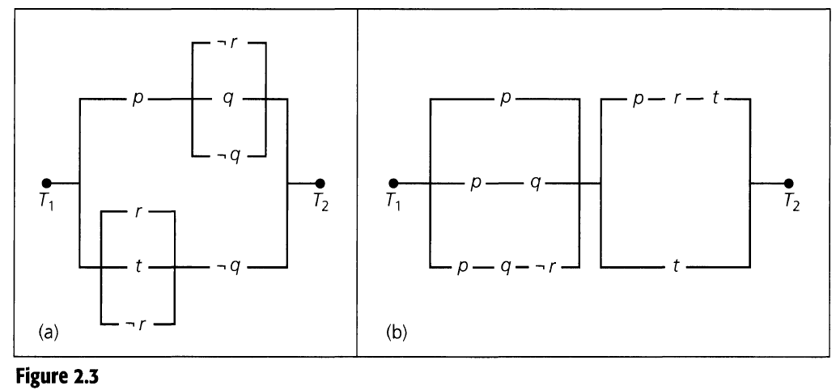
Mathematical Logic

Slide 7
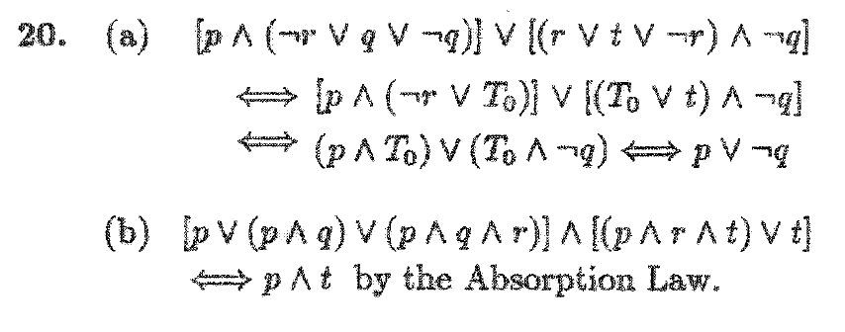
Mathematical Logic

Slide 8
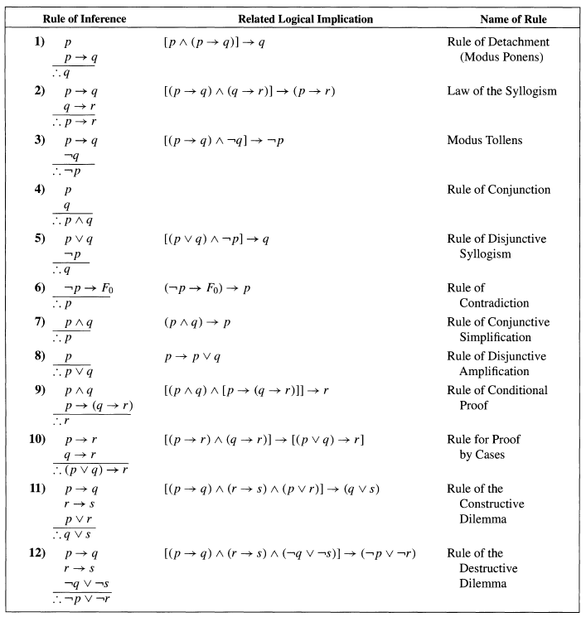
Mathematical Logic : Rules of Inference

Slide 9
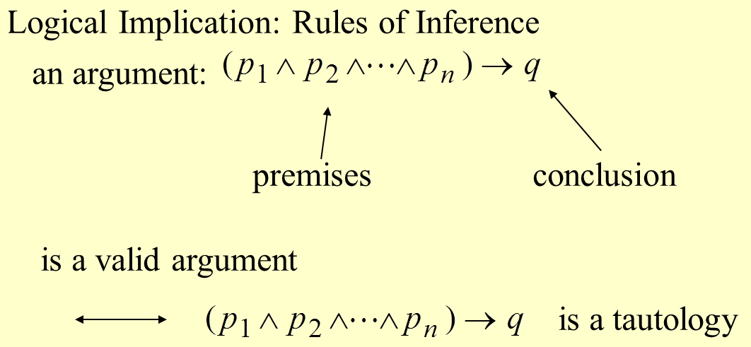
Mathematical Logic : Rules of Inference
p->q p- antecedent (Hypothesis) q -Consequent (Conclusion)

Slide 10
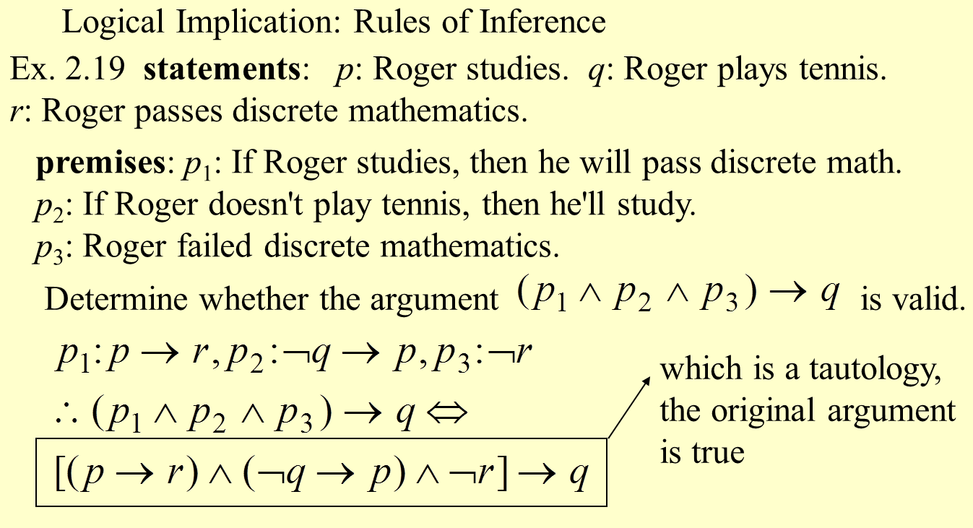
Mathematical Logic : Rules of Inference

Slide 11
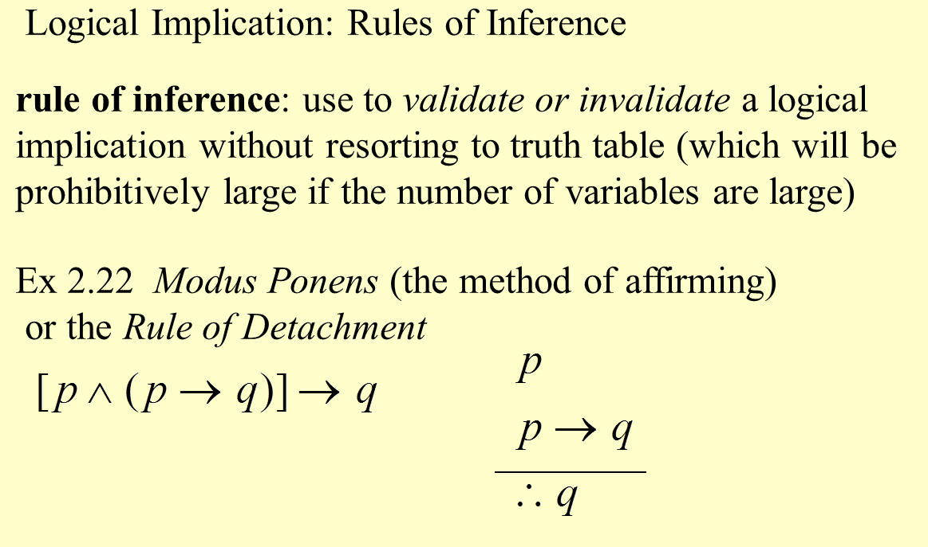
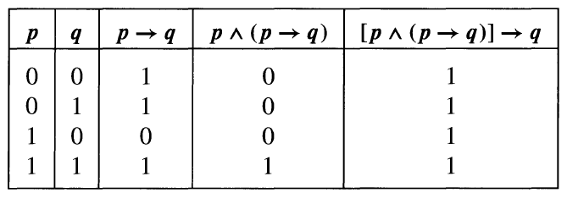
Mathematical Logic : Rules of Inference

Slide 12
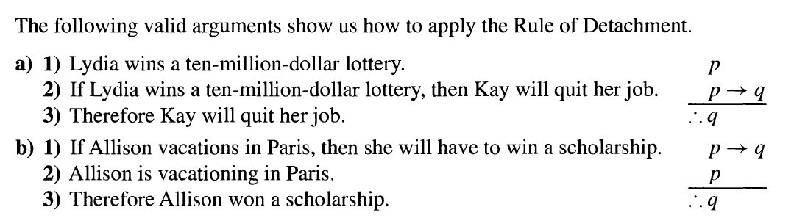
Mathematical Logic : Rules of Inference

Slide 13
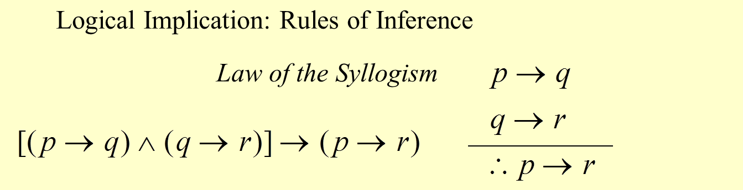
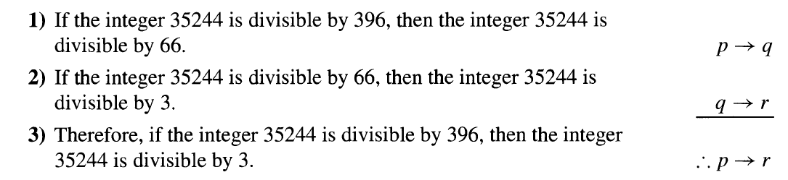
Mathematical Logic : Rules of Inference

Slide 14
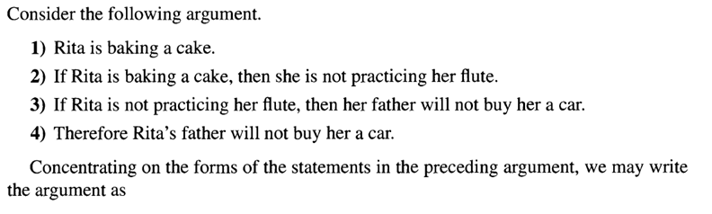
Mathematical Logic : Rules of Inference

Slide 15
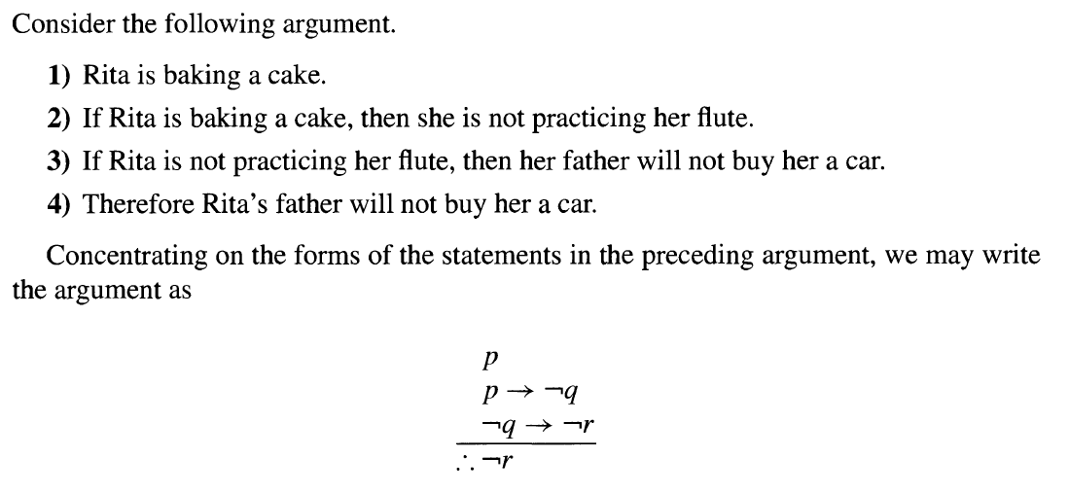
Mathematical Logic : Rules of Inference

Slide 16
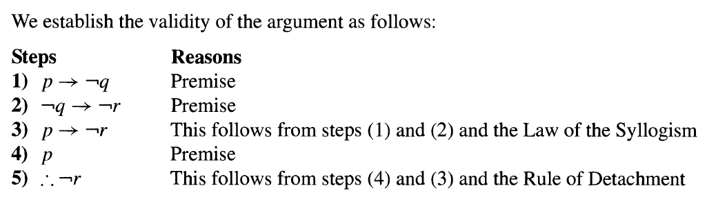
Mathematical Logic : Rules of Inference

Slide 17
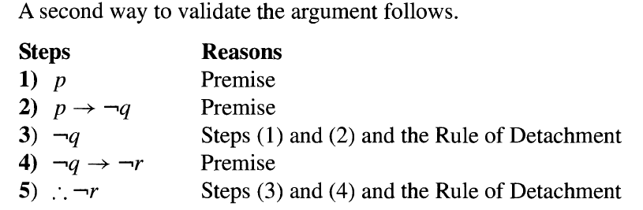
Mathematical Logic : Rules of Inference

Slide 18
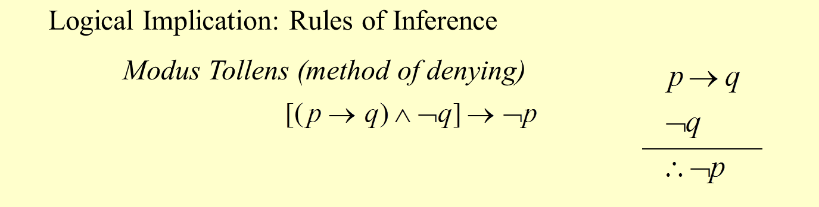
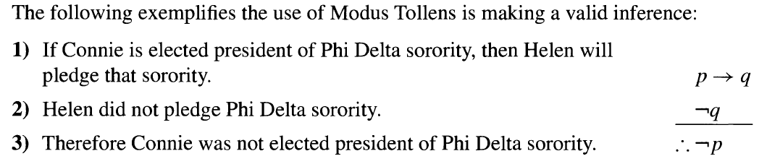
Mathematical Logic : Rules of Inference

Slide 19
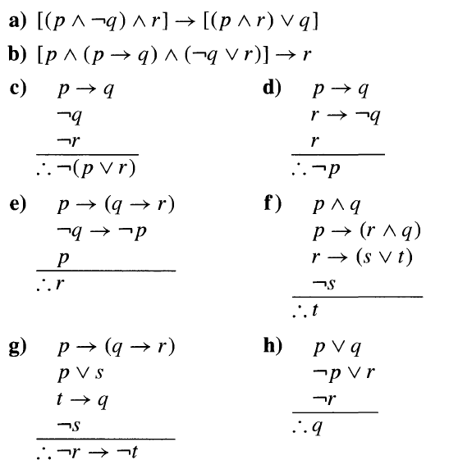
Mathematical Logic : Rules of Inference
10.\

Slide 20
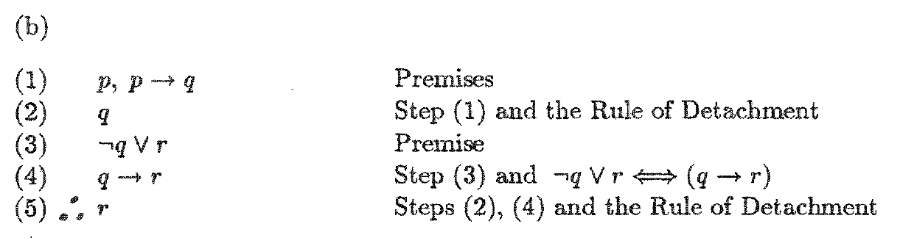
Mathematical Logic : Rules of Inference

Slide 21
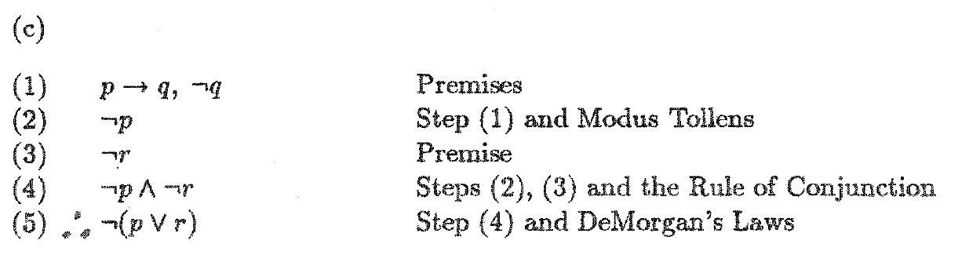
Mathematical Logic : Rules of Inference

Slide 22
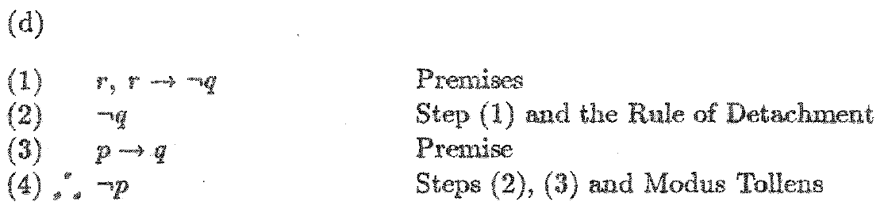
Mathematical Logic : Rules of Inference

Slide 23
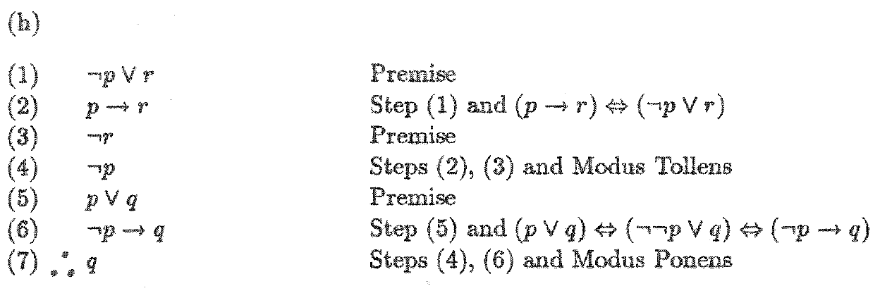
Mathematical Logic : Rules of Inference

Slide 24
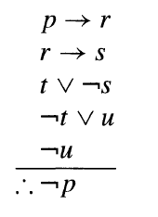
Mathematical Logic : Rules of Inference

Slide 25
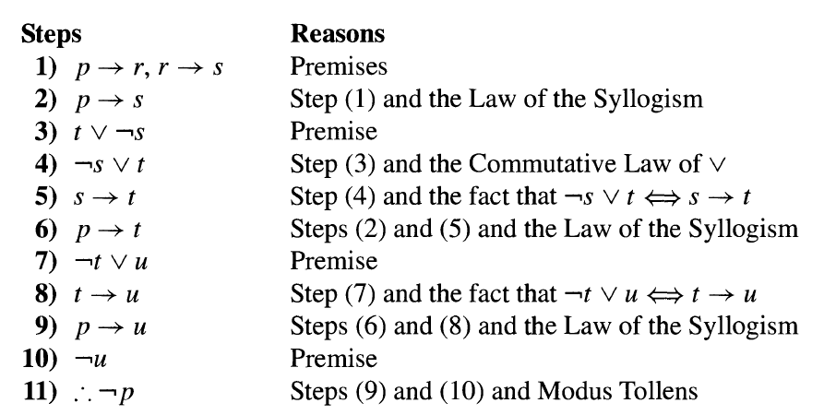
Mathematical Logic : Rules of Inference

Slide 26
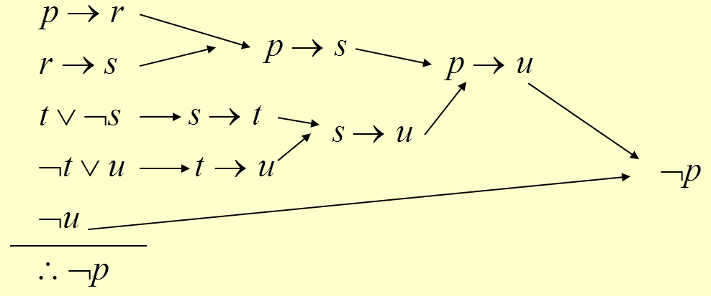
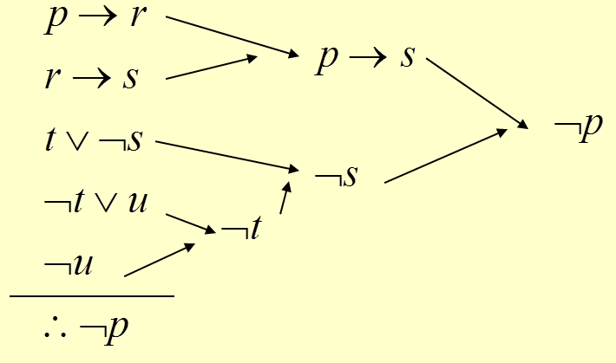
Mathematical Logic : Rules of Inference

Slide 27
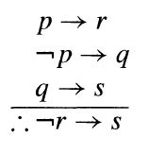
Mathematical Logic : Rules of Inference

Slide 28
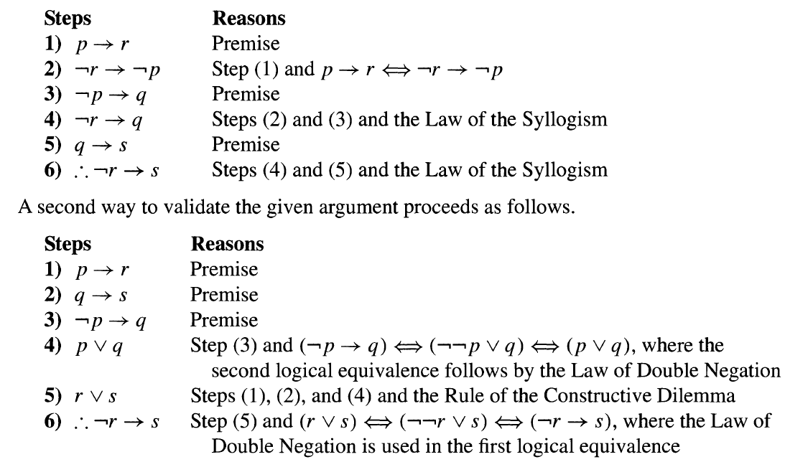
Mathematical Logic : Rules of Inference

Slide 29
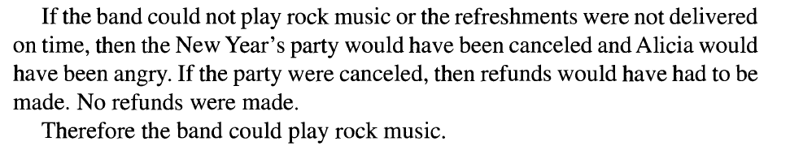
Mathematical Logic : Rules of Inference

Slide 30
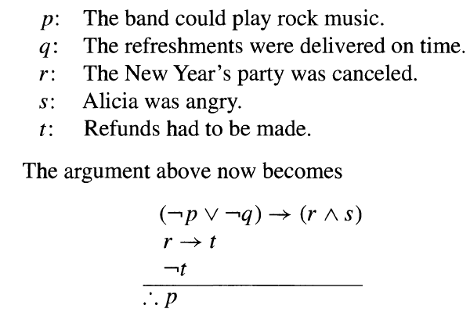
Mathematical Logic : Rules of Inference

Slide 31
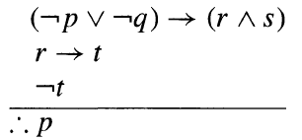
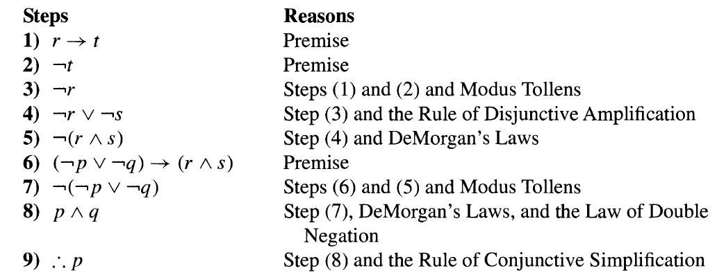
Mathematical Logic : Rules of Inference

Slide 32
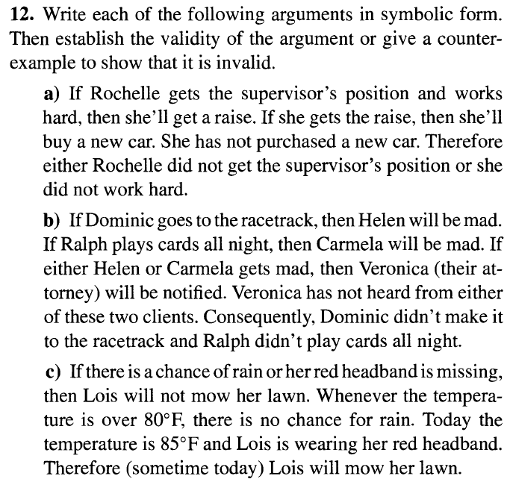
Mathematical Logic : Rules of Inference

Slide 33
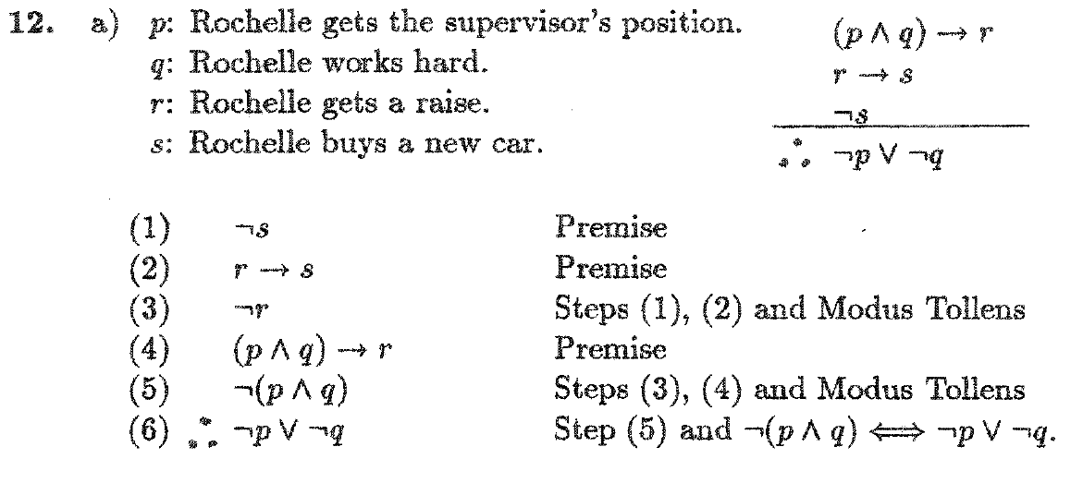
Mathematical Logic : Rules of Inference

